Slide 1
Metadata, Access, and Preservation
Digital Humanities

Slide 2
Definition
Metadata is "data or information that provides information about other data."
Three distinct types of metadata exist:
descriptive metadata,
structural metadata,
and administrative metadata.
Descriptive metadata describes a resource for purposes such as discovery and identification. It can include elements such as title, abstract, author, and keywords.

Slide 3
Definition
Structural metadata is metadata about containers of data and indicates how compound objects are put together, for example, how pages are ordered to form chapters in a book. It describes the types, versions, relationships and other characteristics of digital materials.
Administrative metadata provides information to help manage a resource, such as when and how it was created, file type and other technical information, and who can access it.

Slide 4
History
Metadata was traditionally used in the card catalogs of libraries until the 1980s, when libraries converted their catalog data to digital databases.
In the 2000s, as digital formats were becoming the prevalent way of storing data and information, metadata was also used to describe digital data using metadata standards.
There are different metadata standards for each different discipline (e.g. museum collections, digital audio files, websites, etc.).

Slide 5
History
Describing the contents and context of data or data files increases its usefulness.
For example, a web page may include metadata specifying what software language the page is written in (e.g., HTML), what tools were used to create it, what subjects the page is about, and where to find more information about the subject.
This metadata can automatically improve the reader's experience and make it easier for users to find the web page online.

Slide 6
History
A principal purpose of metadata is to help users find relevant information and discover resources.
Metadata also helps to organize electronic resources, provide digital identification, and support the archiving and preservation of resources.
Metadata assists users in resource discovery by allowing resources to be found by relevant criteria, identifying resources, bringing similar resources together, distinguishing dissimilar resources, and giving location information.

Slide 7
History
Metadata of telecommunication activities including Internet traffic is very widely collected by various national governmental organizations. This data is used for the purposes of traffic analysis and can be used for mass surveillance.
In many countries, the metadata relating to emails, telephone calls, web pages, video traffic, IP connections and cell phone locations are routinely stored by government organizations.

Slide 8
Purpose
Some examples of what metadata is often used for includes:
Means of creation of the data
Purpose of the data
Time and date of creation
Creator or author of the data
Location on a computer network where the data was created
Standards used
File size

Slide 9
Purpose
A digital image may include metadata that describes how large the picture is, the color depth, the image resolution, when the image was created, the shutter speed, and other data.
A text document's metadata may contain information about how long the document is, who the author is, when the document was written, and a short summary of the document.

Slide 10
Purpose
Metadata within web pages can also contain descriptions of page content, as well as key words linked to the content. These links are often called "Metatags", which were used as the primary factor in determining order for a web search until the late 1990s.
The reliance of metatags in web searches was decreased in the late 1990s because of "keyword stuffing".
Metatags were being largely misused to trick search engines into thinking some websites had more relevance in the search than they really did.

Slide 11
Purpose
The term "metadata" was coined in 1968 by Philip Bagley, in his book "Extension of Programming Language Concepts".
Since then the fields of information management, information science, information technology, librarianship, and GIS have widely adopted the term.
In these fields the word metadata is defined as "data about data". While this is the generally accepted definition, various disciplines have adopted their own more specific explanation and uses of the term.

Slide 12
Structures
Metadata (metacontent) or, more correctly, the vocabularies used to assemble metadata (metacontent) statements, is typically structured according to a standardized concept using a well-defined metadata scheme, including: metadata standards and metadata models.
Tools such as controlled vocabularies, taxonomies, thesauri, data dictionaries, and metadata registries can be used to apply further standardization to the metadata.
Structural metadata commonality is also of paramount importance in data model development and in database design.

Slide 13
Syntax
Metadata (metacontent) syntax refers to the rules created to structure the fields or elements of metadata (metacontent). A single metadata scheme may be expressed in a number of different markup or programming languages, each of which requires a different syntax. For example, Dublin Core may be expressed in plain text, HTML, XML, and RDF.

Slide 14
Hierarchical, linear, and planar schemata
Metadata schemata can be hierarchical in nature where relationships exist between metadata elements and elements are nested so that parent-child relationships exist between the elements.
An example of a hierarchical metadata schema is the IEEE LOM schema, in which metadata elements may belong to a parent metadata element.

Slide 15
Hierarchical, linear, and planar schemata
Metadata schemata can also be one-dimensional, or linear, where each element is completely discrete from other elements and classified according to one dimension only. An example of a linear metadata schema is the Dublin Core schema, which is one dimensional.
Metadata schemata are often two dimensional, or planar, where each element is completely discrete from other elements but classified according to two orthogonal dimensions.

Slide 16
Granularity
The degree to which the data or metadata is structured is referred to as its "granularity".
"Granularity" refers to how much detail is provided.
Metadata with a high granularity allows for deeper, more detailed, and more structured information and enables greater levels of technical manipulation.
A lower level of granularity means that metadata can be created for considerably lower costs but will not provide as detailed information.

Slide 17
Standards
International standards apply to metadata.
Much work is being accomplished in the national and international standards communities, especially ANSI (American National Standards Institute) and ISO (International Organization for Standardization) to reach consensus on standardizing metadata and registries.

Slide 18
Use
Metadata can be written into a wide variety of digital formats, including:
Photographs
Telecommunications
Video
Webpages

Slide 19
Creation
Metadata can be created either by automated information processing or by manual work.
Elementary metadata captured by computers can include information about when an object was created, who created it, when it was last updated, file size, and file extension. In this context an object refers to any of the following:
A physical item such as a book, CD, DVD, a paper map, chair, table, flower pot, etc.
An electronic file such as a digital image, digital photo, electronic document, program file, database table, etc.

Slide 20
Library and Information Science
Metadata has been used in various ways as a means of cataloging items in libraries in both digital and analog format.
Such data helps classify, aggregate, identify, and locate a particular book, DVD, magazine or any object a library might hold in its collection.
Until the 1980s, many library catalogues used 3x5 inch cards in file drawers to display a book's title, author, subject matter, and an abbreviated alpha-numeric string (call number) which indicated the physical location of the book within the library's shelves.
The Dewey Decimal and Library of Congress Systems employed by libraries for the classification of library materials by subject is an early example of metadata usage.

Slide 21
Library and Information Science
Beginning in the 1980s and 1990s, many libraries replaced these paper file cards with computer databases.
These computer databases make it much easier and faster for users to do keyword searches.
This data is stored in the integrated library management system, ILMS, using the MARC metadata standard.
The purpose is to direct patrons to the physical or electronic location of items or areas they seek as well as to provide a description of the item/s in question.

Slide 22
Library and Information Science
More recent and specialized instances of library metadata include the establishment of digital libraries including e-print repositories and digital image libraries.
While often based on library principles, the focus on non-librarian use, especially in providing metadata, means they do not follow traditional or common cataloging approaches.
Given the custom nature of included materials, metadata fields are often specially created e.g. taxonomic classification fields, location fields, keywords or copyright statement.

Slide 23
Library and Information Science
Standard file information such as file size and format are usually automatically included.
Library operation has for decades been a key topic in efforts toward international standardization.
Standards for metadata in digital libraries include: Dublin Core, METS, MODS, DDI, DOI, URN, PREMIS schema, EML, and OAI-PMH.
Leading libraries in the world guide metadata standards by sharing their strategies.

Slide 24
Storage
Metadata can be stored either internally, in the same file or structure as the data (this is also called embedded metadata), or externally, in a separate file or field from the described data.
A data repository typically stores the metadata detached from the data, but can be designed to support embedded metadata approaches.

Slide 25
Sites to Explore
Metapicz
http://metapicz.com/#landing
Extractmetadata
http://www.extractmetadata.com/
Metadata Games
http://www.metadatagames.org/get-involved/

Slide 26
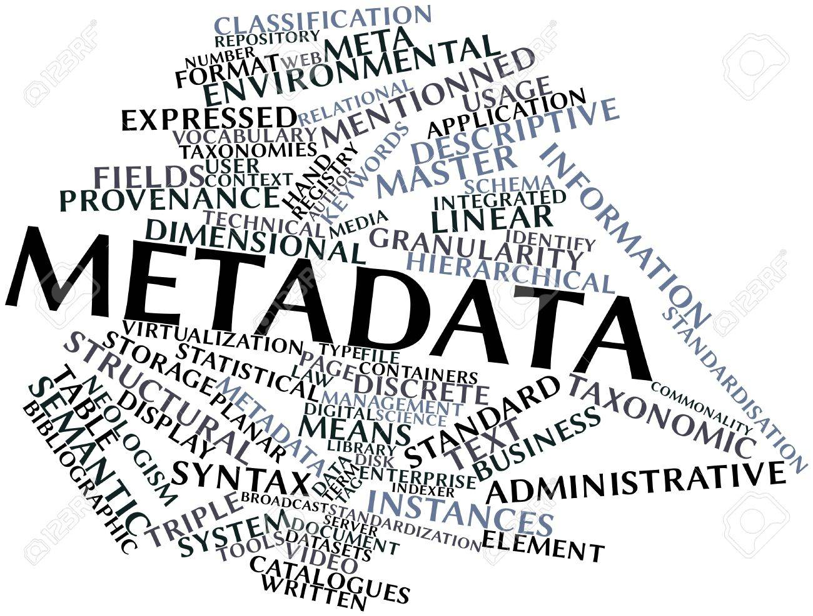
Next class…
Metadata Lab

